Slide 1

AN OPINIONATED GUIDE TO FLOW CHARTS

Slide 2
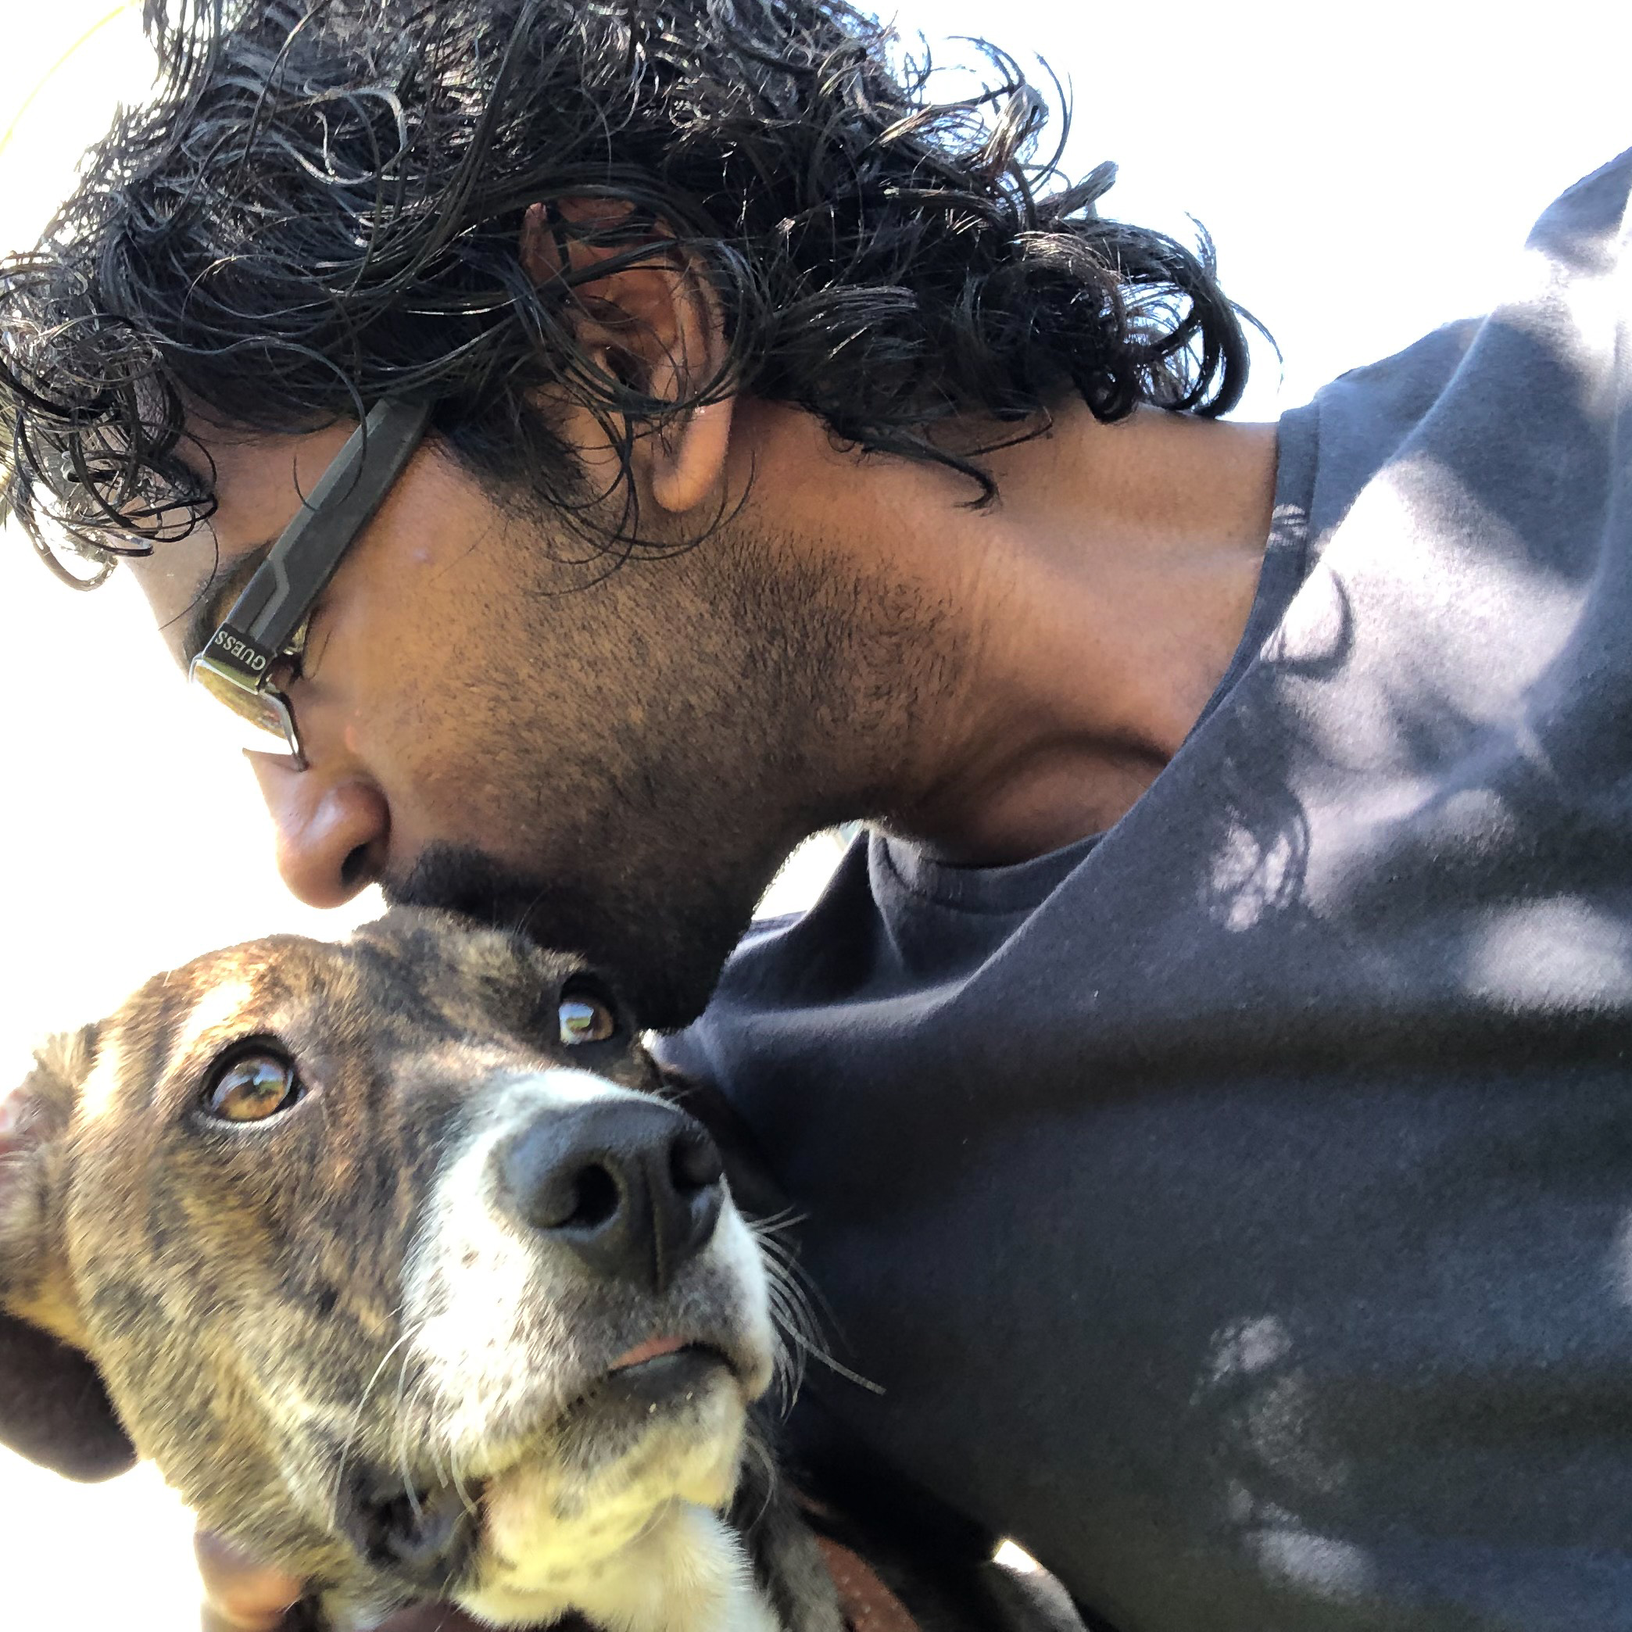
Hello world!
I AM AVI JIVAN
I wish I could adopt all the dogs. Alas, I volunteer at shelters until then.
I’ve built a pet adoption App: SnoutForJoy.com

Slide 3
Why flowcharts?
Translating business desires into system functionality and documenting solutions for different audiences

Slide 4
Audiences
Business
Ensure the business problem is solved
Developers
Build the requirements specified
Legal
Ensure legal and regulatory rules are followed
Testers
Create test cases

Slide 5
Flowcharts are unambiguous
Requirements can be complex and there may be several decision points
Not everyone understands all symbols, but everyone must understand the flowchart
A working approach to using flow charts is required...

Slide 6
Granularity?
Showing an end-to-end process
Exploding a specific portion of a process
Orchestrations (business, or system processes)
Illustrating decisions and logic
Specifying algorithms

Slide 7
Granularity…
Who is the target audience and what do they need to know?
Do you need several flow charts?

Slide 8
Granularity!
A business team concerned with training users may not be interested in incrementing a variable named x, or y, or n, or whatever
A development team concerned with the data types in the response of a web service may not be interested in the user taking a photo of their puppy using a separate device

Slide 9
One too many flowcharts
Ideally a flow chart tailored to each audience for each purpose
Takes a lot of effort. There’s just not enough time…
Unmaintainable in our industry. We’re not building bridges. Requirements change often
Base flow charts with exploded views where necessary

Slide 10
Ovals
Start
End
Start and end points

Slide 11
Rectangles
Fetch all puppies available using the puppyService
To describe an action

Slide 12
Diamonds
For what type of pet is the user searching?
For decisions

Slide 13
Labels on lines
Use version 1 of the puppyService
For giving additional context

Slide 14
Legend
Legend
Solid black lines represents the main system flow
Dashed pink lines represent a manual process
For stating what different line styles and colours mean

Slide 15
Swimlanes
Adopter I’ll look for puppies that I want to adopt
Shelter I’ll process the adoption
Inspector I’ll do a home inspection
For representing the roles of different stakeholders

Slide 16
Blackboxes
Fetch all puppies available using the puppyService
Fetch pets
available for
adoption
Order by name, then breed
To label portions that you can reuse later

Slide 17
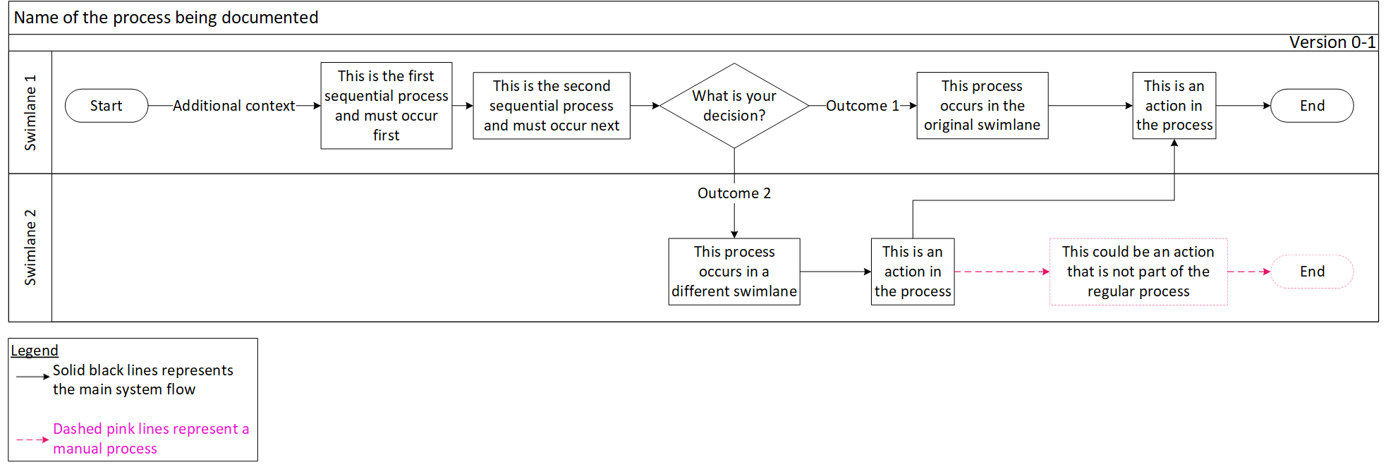
Putting it together

Slide 18
Exercise
Let’s assume that the following process is used to verify that a potential pet adopter qualifies to adopt a pet they see

Slide 19
A potential adopter looks at different pets available for adoption and sees one she wants to adopt.
She checks with the shelter administrator if that pet is still available for adoption. If the pet is available, then the shelter administrator sends the potential adopter a form to complete with her details so that a home inspection can be done to ensure that the potential adopter meets the shelter’s adoption criteria.
When the potential adopter returns the completed form, the shelter administrator schedules a date for the home inspection with the inspection officer. The inspection officer then conducts the inspection with the potential adopter.
If the inspection is a success, then the inspection officer informs the shelter administrator of such. The shelter administrator then starts processing the adoption.
Sample solution:

Slide 20
Thanks!
ANY QUESTIONS?
You can find me at:
arjivan.com
linkedin.com/in/arjivan
avinash.r.jivan@gmail.com

Slide 21
Credits
Special thanks to all the people who made and released these awesome resources for free:
Presentation template by SlidesCarnival

